Slide 1
Cloud DevOps

Slide 2
Domain 1 - SDLC Automation Continuous Integration
Developers push the code to a code repository often (GitHub, CodeCommit, Bitbucket etc…)
A testing/build server checks the code as soon as it’s pushed (CodeBuild/Jenkins etc…)
The developer gets feedback about the tests and checks that have passed or failed
Find bugs early, fix bugs
Deliver faster as the code is tested
Deploy often
Happier developers, as they’re unblocked

Slide 3
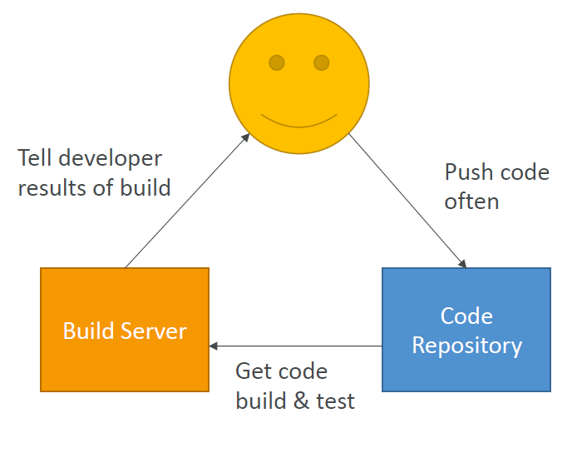
Domain 1 - SDLC Automation Continuous Integration

Slide 4
Domain 1 - SDLC Automation Continuous Delivery
Ensure that the software can be released reliably whenever needed.
Ensures deployments happen often and are quick
Shift away from “one release every 3 months” to ”5 releases a day”
That usually means automated deployment
CodeDeploy
Jenkins CD
Spinnaker
Etc…..

